Slide 1
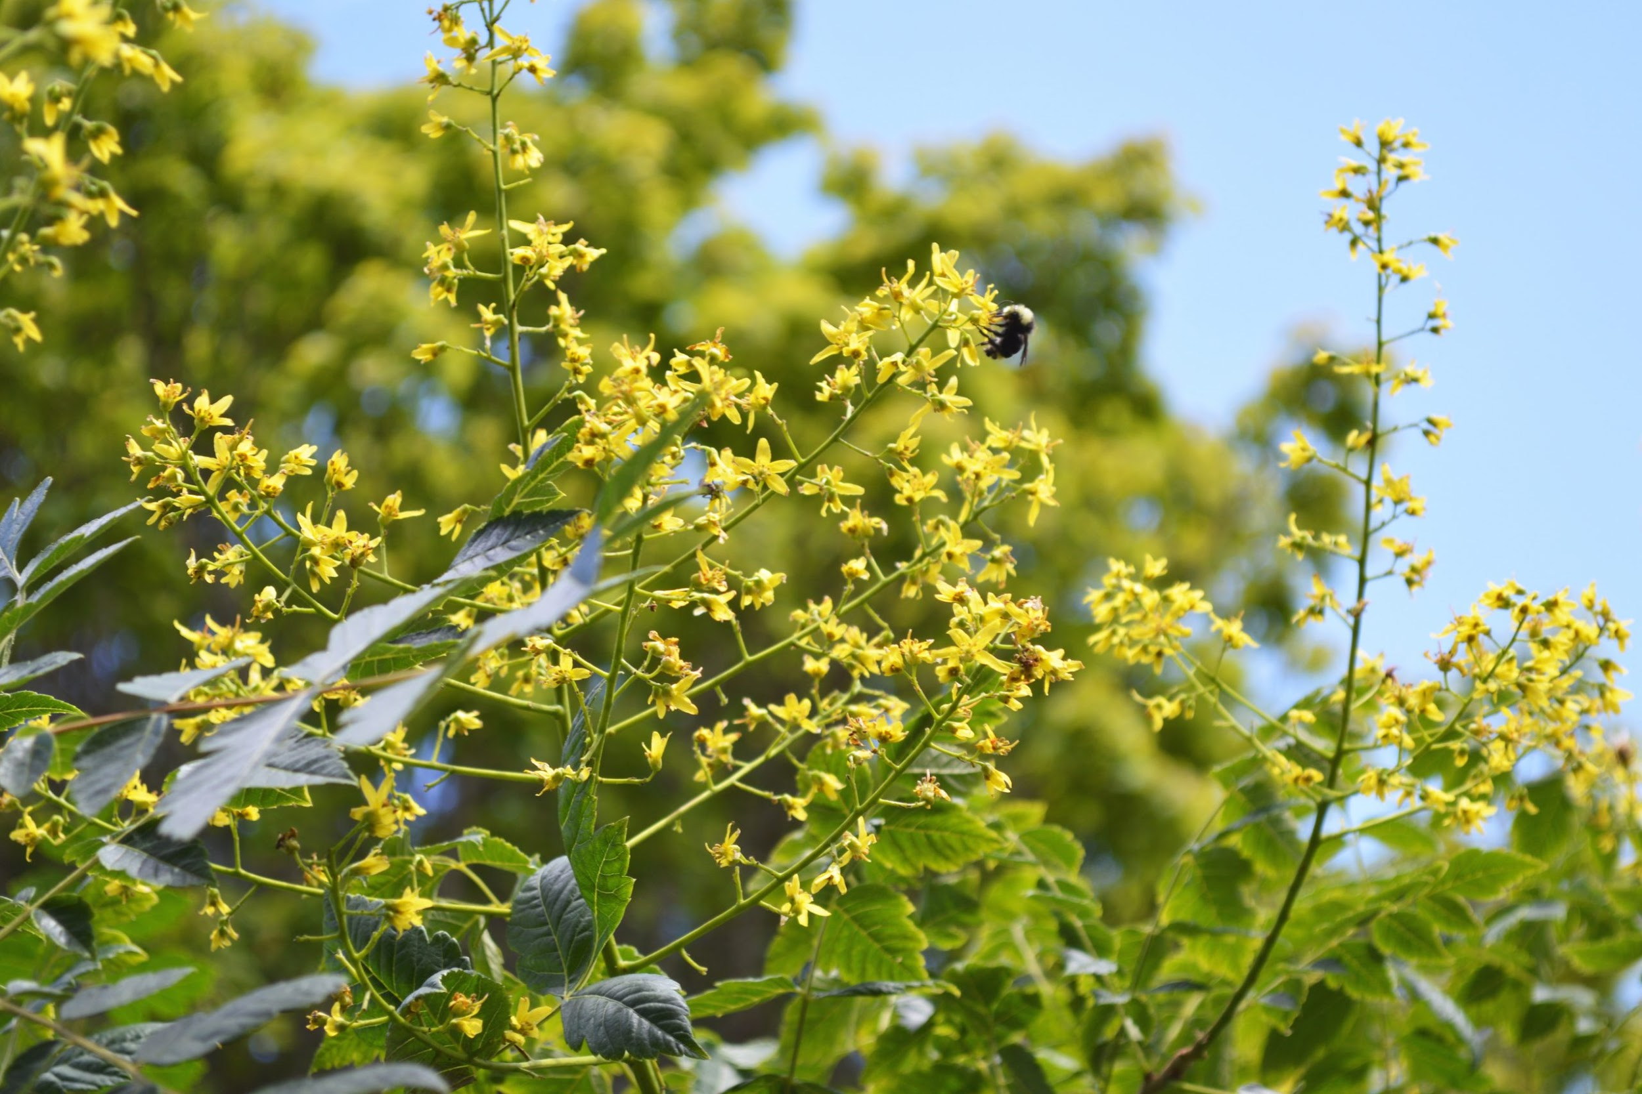
Team Round Robin Teambuilder

Slide 2
Instructions
Everyone will answer every question
The person to answer first will change CLOCKWISE with each question
Use up all your time! After everyone gets a turn to speak, keep discussing

Slide 3
This one’s a 2-parter!
What is your name?
Do you have siblings?
If yes, who are they?

Slide 4
Do you have pets?
If yes, who are they?

Slide 5
What is a food you enjoy?

Slide 6
What is your favorite season?

Slide 7
If you could compete in the Olympics, which sport would you like to compete in?

