Slide 1
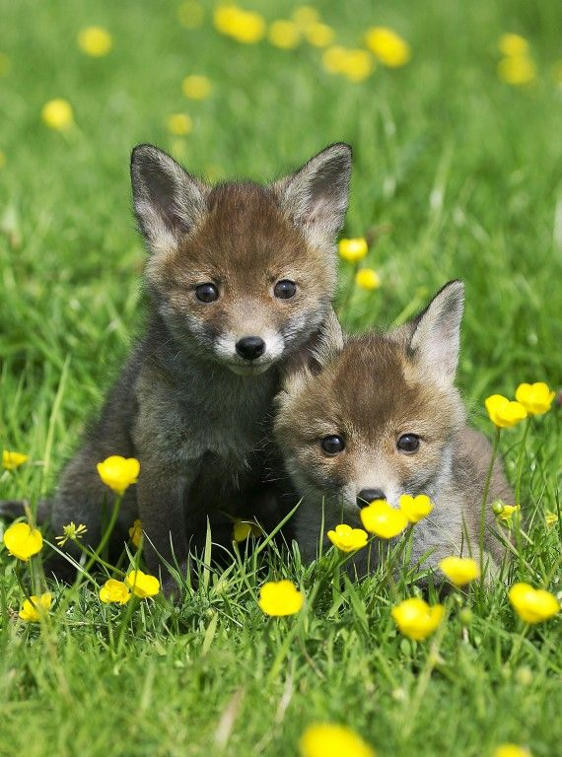
The List Game

Slide 2
Comment ça marche (How it works)
One person is chosen to write for the round (a different person must be used for each round)
You have three minutes to name as many things as you can in the category and make a list of them
After three minutes, you trade lists with another team and count how many things they wrote
The team with the most reads their list aloud and they get a point
Move on to other rounds. A new person writes
The team with the most points wins!

Slide 3
Round 1
Types of Candy Bar

Slide 4
Round 2
Types of vegetables

Slide 5
Round 3
Countries

Slide 6
Round 4
Things that are COLD

Slide 7
Round 5
Emotions

